Slide 1
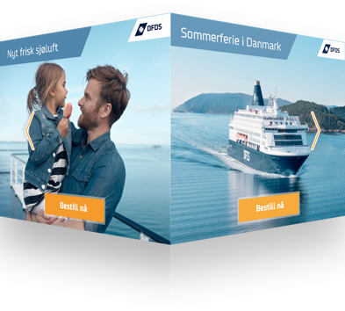
CHALLENGE
After a period of strict travel restrictions due to the COVID-19 pandemic, shipping and logistics company, DFDS Seaways, wanted to drive ticket sales for their routes in Northern Europe.
APPROACH
The opportunity for DFDS customers to bring a car on board their journey was identified this as a perfect angle to attract the target audience of holiday-making families. The audience segments were obtained using [m]insights and publisher data, before being deployed using the Xandr DSP.
Xaxis Creative Studios, the in-house creative and interactive execution shop, was then leveraged to enhance the campaign’s creative. The ads were displayed using an interactive Prism rich media unit, a 300x250px adspace that enabled users to swipe through different panels and create narrative by engaging with DFDS’ content.
The interactive creative, and the swipe function proved particularly successful amongst mobile device users, significantly increasing user engagement and clicks through to DFDS’ website.
OUTCOME
EFFICIENTLY INCREASING CONVERSION RATES WITH INTERACTIVE CREATIVE
45%
Decrease in CPA
300%
Increase in conversion rate
8%
Decrease in CPC
136%
Increase in CTR
XAXIS Denmark, 2020
Notes:
This an overview slide. This is not meant to an exhaustive summary of the entire case, just top level details. You should go into depth on the slides after this. High-resolution logos and images ALWAYS matter. Any stats should be in comparison to a client benchmark. Look at examples.

Slide 2
CHALLENGE
Danish international shipping and logistics company, DFDS Seaways, wanted to sell tickets for their sailing routes between Oslo, Copenhagen and Fredrikshavn in Denmark.
After a period of strict travel restrictions due to the COVID-19 pandemic, many consumers were left feeling uncertain about travelling overseas. DFDS and Xaxis had to find an approach that addressed this issue whilst achieving DFDS’ goal of increasing awareness by reaching unique users online, specifically mobile.
We know that the attention span of users on mobile is very low, therefore a high impact and engaging format was key in order to attract users to DFDS’ ticket offers.
Notes:
Here you want to introduce and expand on the main challenges the client was facing. The challenge here should not the the Xaxis’s challenge but rather the CLIENT’s challenge. Why did the client come to Xaxis?
The key here is to create a compelling story. Don’t just list the challenges; go a little deeper into the impact the challenges were having on their overall business.
Explain why it was important to solve them, why and how they were impacting the client, and to what degree. Do this with two or three key challenges, as long as they tell a specific story related to the solution.

Slide 3
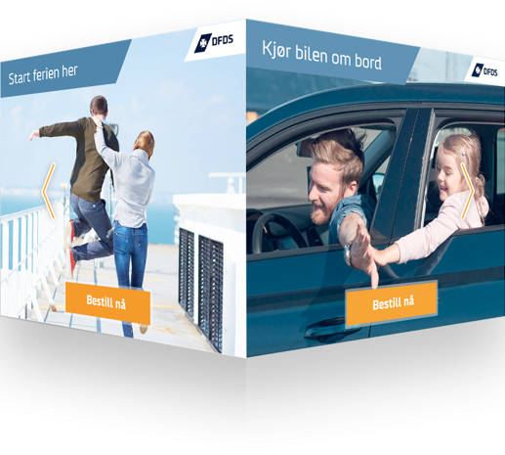
APPROACH
The opportunity for DFDS customers to bring a car on board their journey became the focal point of the campaign. The team identified this as a perfect angle to attract the target audience of holiday-making families.
Using data segments from GroupM’s audience database tool, [m]insights, as well as publisher data made available through private deals, the team were able to identify an audience of families with children and travel-intent/interest. Combinations of these audience segments were then prioritised and deployed using the Xandr DSP.
Xaxis Creative Studios, the in-house creative and interactive execution shop, was leveraged to enhance the campaign’s creative. The ads were displayed using an interactive Prism rich media unit, a 300x250px adspace that enabled users to swipe through different panels and create narrative by engaging with DFDS’ content.
Being a fundamental aspect of the mobile user interface, the swipe function proved particularly successful amongst mobile device users, increasing user engagement and clicks through to DFDS’ website.
Notes:
In this section, document the journey to the solution and the results. This section adds depth and credibility to your story. This is where you showcase the product or service as the answer to the customer’s challenges. Explain how the product or service was implemented. The key to this section is to paint an accurate picture with word. It’s rare for an implementation to go 100% perfectly. So, to boost the authenticity of this section, document how the implementation went — warts and all — and then how the company overcame it. This will make the story more believable and compelling.

Slide 4
OUTCOMES
Compared to other prospecting across the campaign, Xaxis’ creative studios and the swipe cube format saw performance increase significantly across all KPI’s, including a 300% increase in conversion rate and a 45% decrease in CPA.
45%
Decrease in CPA
300%
Increase in conversion rate
8%
Decrease in CPC
136%
Increase in CTR
Conversion rate (Other Prospecting)
Conversion rate (Xaxis’ Swipe Cube)
Notes:
This is where you detail how well the product or service solved the mentioned challenges. Focus on results metrics (tables, charts, increases in production, efficiency, revenue, etc.) that are both specific and relevant to the target audience. Say what was achieved and how.
Explain why the results are important to the customer and the impact they’ve had, both specific to the department the results were achieved in and the impact on the overall business.

